Slide 1
CONFIGURABLE ASSIGNMENT RULE APP
For Lightning Experience

Slide 2
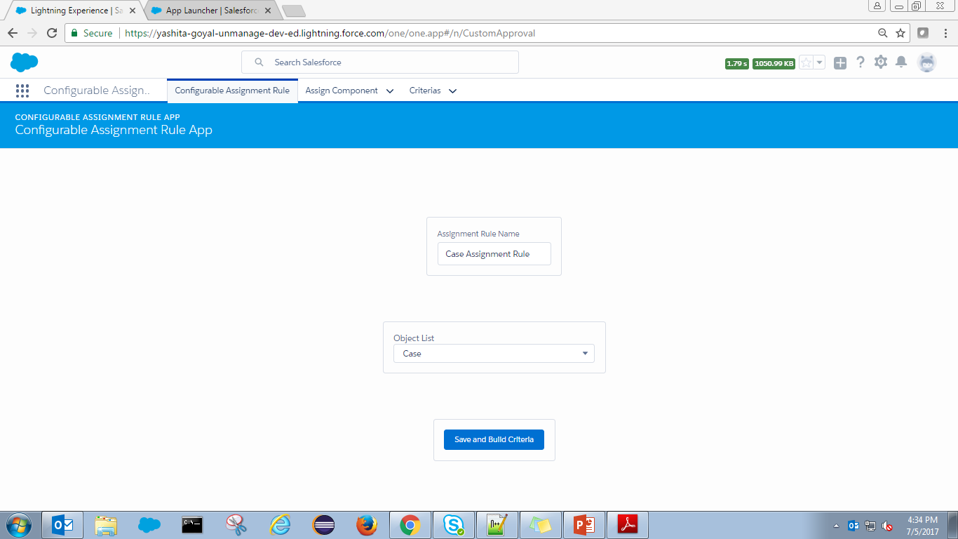
Configurable Assignment Rule App (1/13)
The app will contain 3 Tabs:
Configurable Assignment Rule
Assign Component
Criteria
Configurable Assignment Rule Tab:
User will enter Assignment Rule Name and Select Object from Object List
Screen has validation, success messages in-place
On click of button ‘Save and Build Criteria’, record is created for Assign Component Object

Slide 3
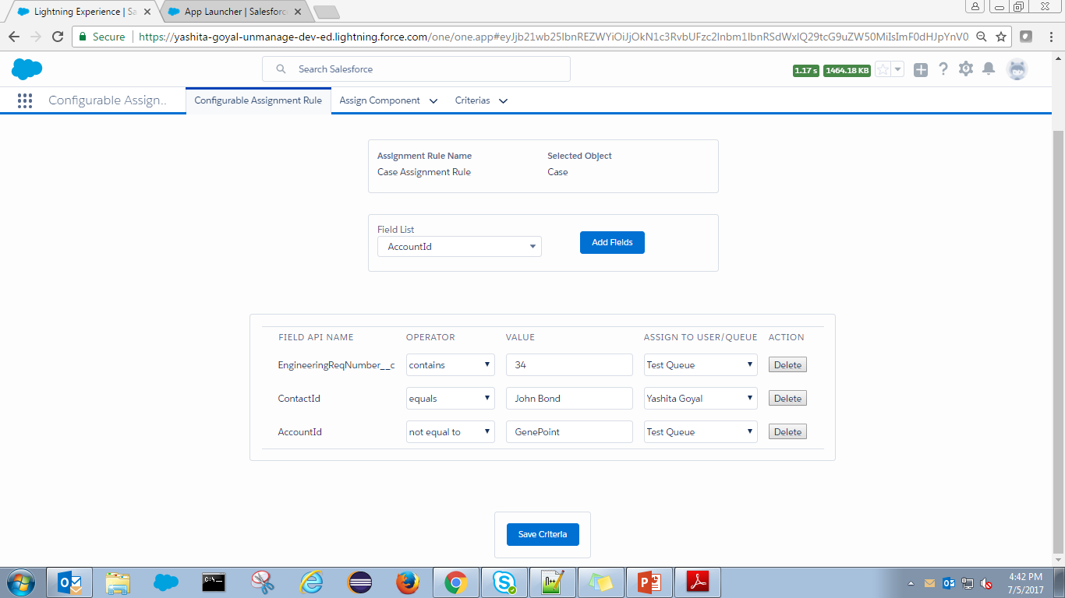
Configurable Assignment Rule App (2/13)
User will select Field from ‘Field List’ and click on ‘Add Fields’ button:
Fields get added in the below table specifying Operator, Value, Assign To User or Queue
User have an option to Delete any wrong criteria added

Slide 4
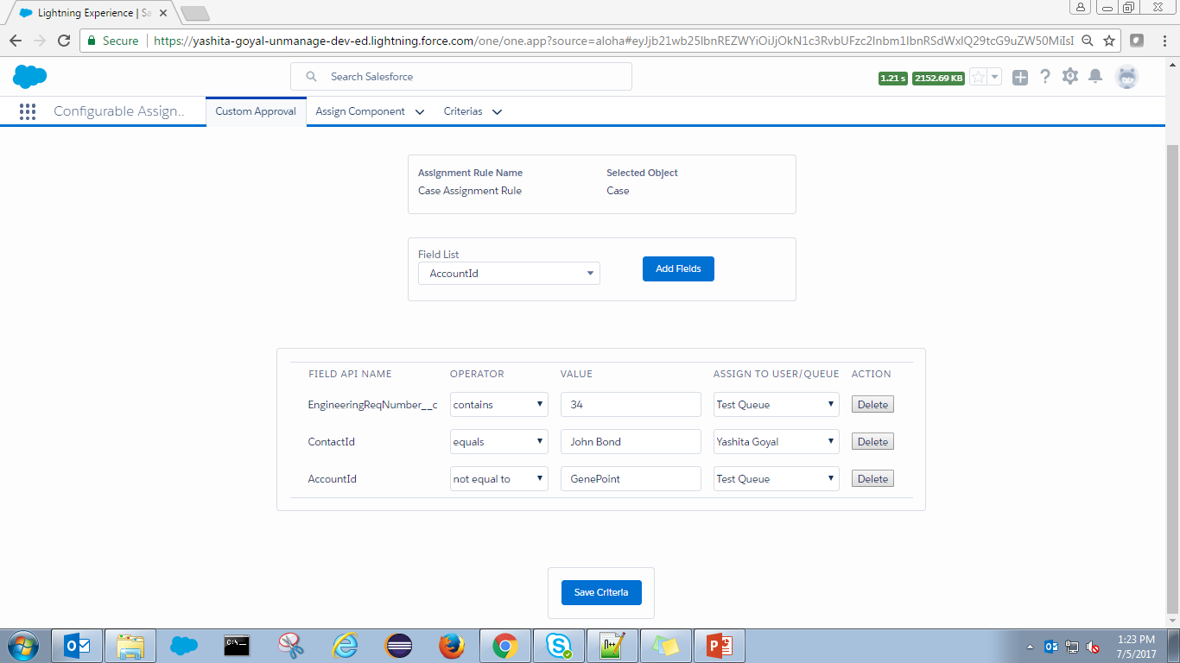
Configurable Assignment Rule App (3/13)
Upon click of ‘Save and Build Criteria’:
Assign Component object is created
User is redirected to next component to set criteria

Slide 5
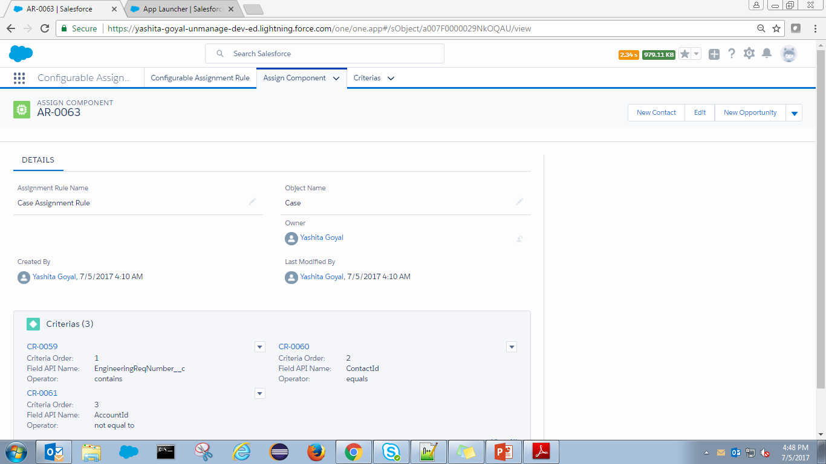
Configurable Assignment Rule App (4/13)
Assign Component Tab:
Record is created with Assignment Rule Name and Object Name values populated
Object has Child object named ‘Criteria’
Criteria object will contain all the criteria added in sequential order

Slide 6
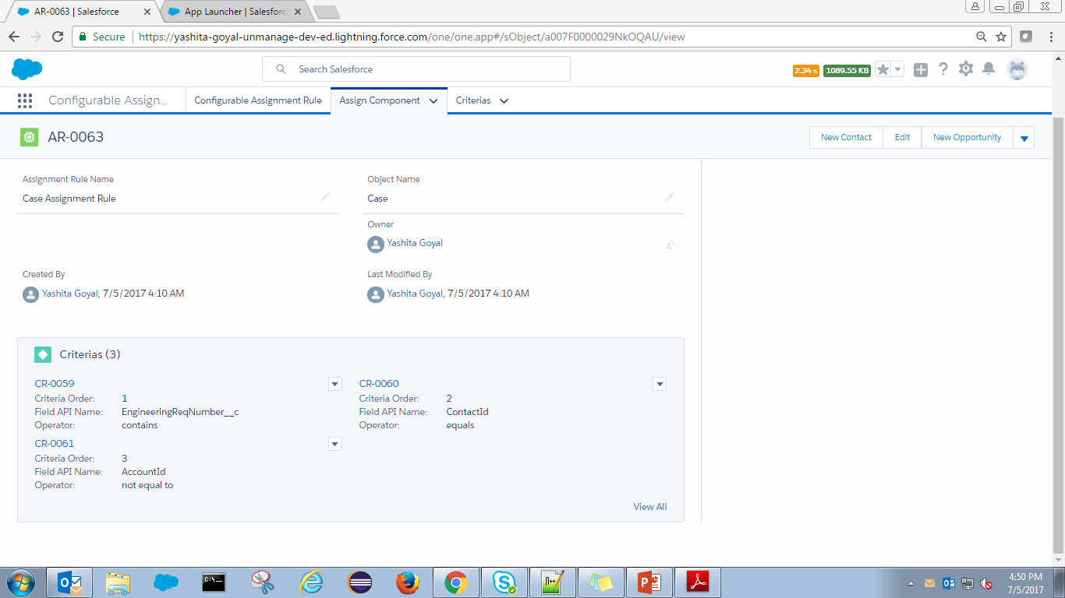
Configurable Assignment Rule App (5/13)
Child records ‘Criteria’ are added under respective Assign Component record
Automatic Trigger creation on the particular Object inclusive calling of generic handler class

Slide 7
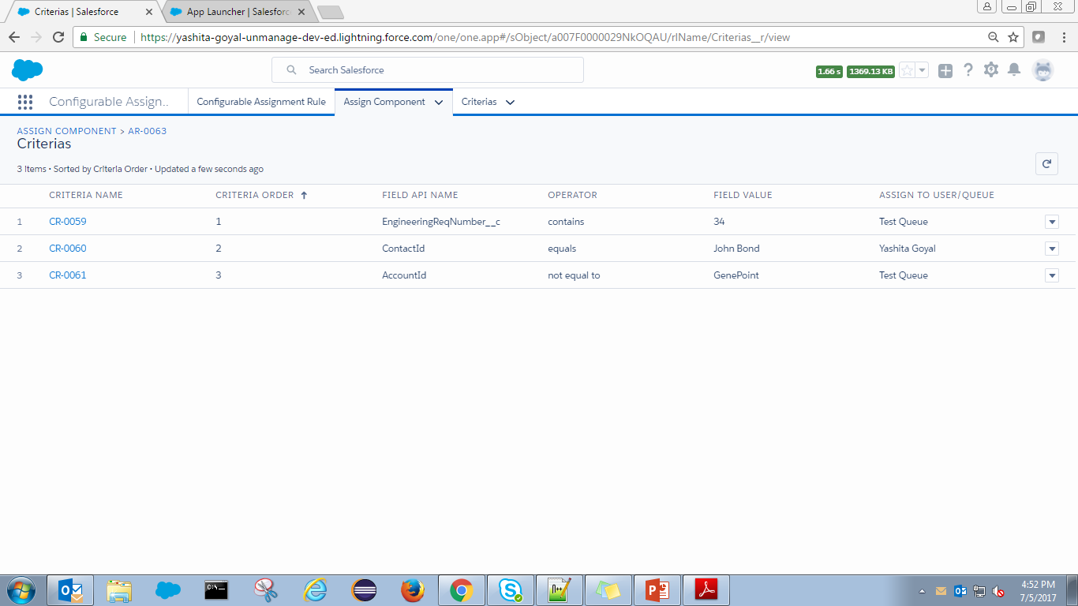
Configurable Assignment Rule App (6/13)
Criteria Related List on Assign Component record:
Record is created
Criteria Order is set in the order user entered the criteria

Slide 8
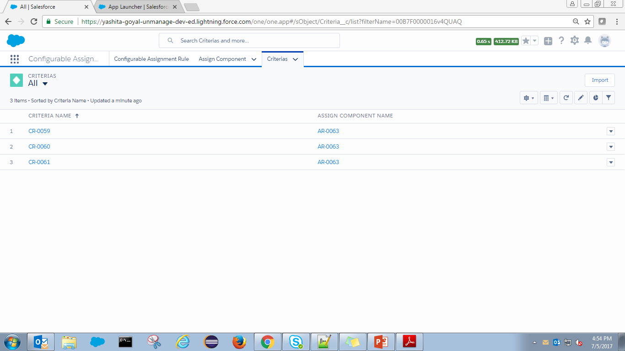
Configurable Assignment Rule App (7/13)
Criteria Tab:
To view criteria records and association with Assign Component record

Slide 9
Configurable Assignment Rule App (8/13)
Key Highlights:
As per Salesforce OOTB, at a time only one Assignment Rule can be in Active State. The same is followed by Configurable Assignment Rule App. User can create one custom assignment rule per object
Assign Component and Criteria is in Master Detail relationship
Necessary Success and Validation error messages are applied
Automatic After Insert, After Update Trigger creation once assignment rule is created on that object
Common Trigger Handler is created to make the whole functionality in working condition
Simple and easy to use
Limitations:
Lightning framework is an evolving feature and might have some gaps compared to Salesforce Classic

Slide 10
Configurable Assignment Rule App (9/13)
Example:
Assignment Rule for Case with following criteria as shown below:

Slide 11
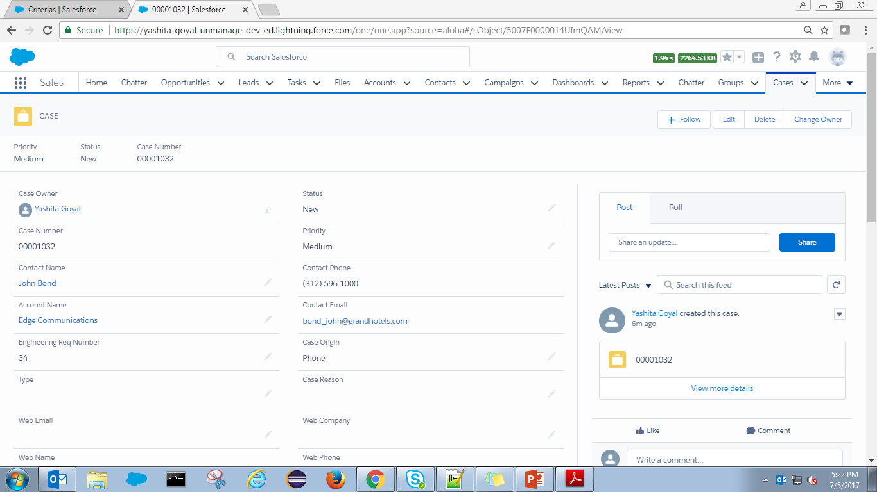
Configurable Assignment Rule App (10/13)
Example:
Case record is created with values as shown in screenshot below:

Slide 12
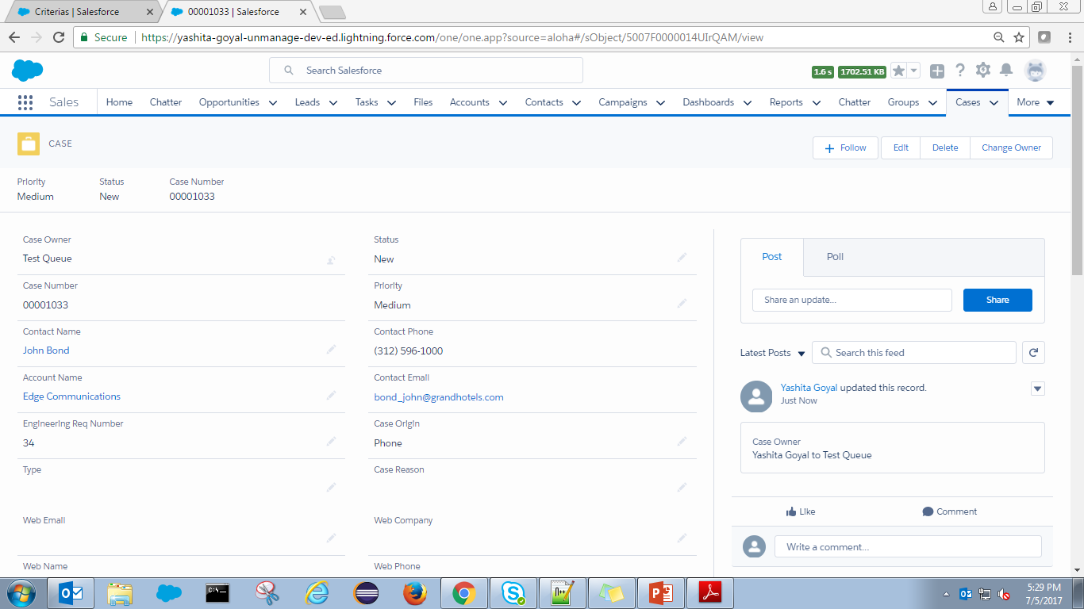
Configurable Assignment Rule App (11/13)
Example:
Case record is created with values as shown in screenshot below:
When Case record is created, custom assignment rule runs in the background and accordingly assigns the record.
In our scenario, Engineering Required Number satisfies the criteria.
So the record ownership is assigned to Test Queue

Slide 13
Thank You

